Slide 1
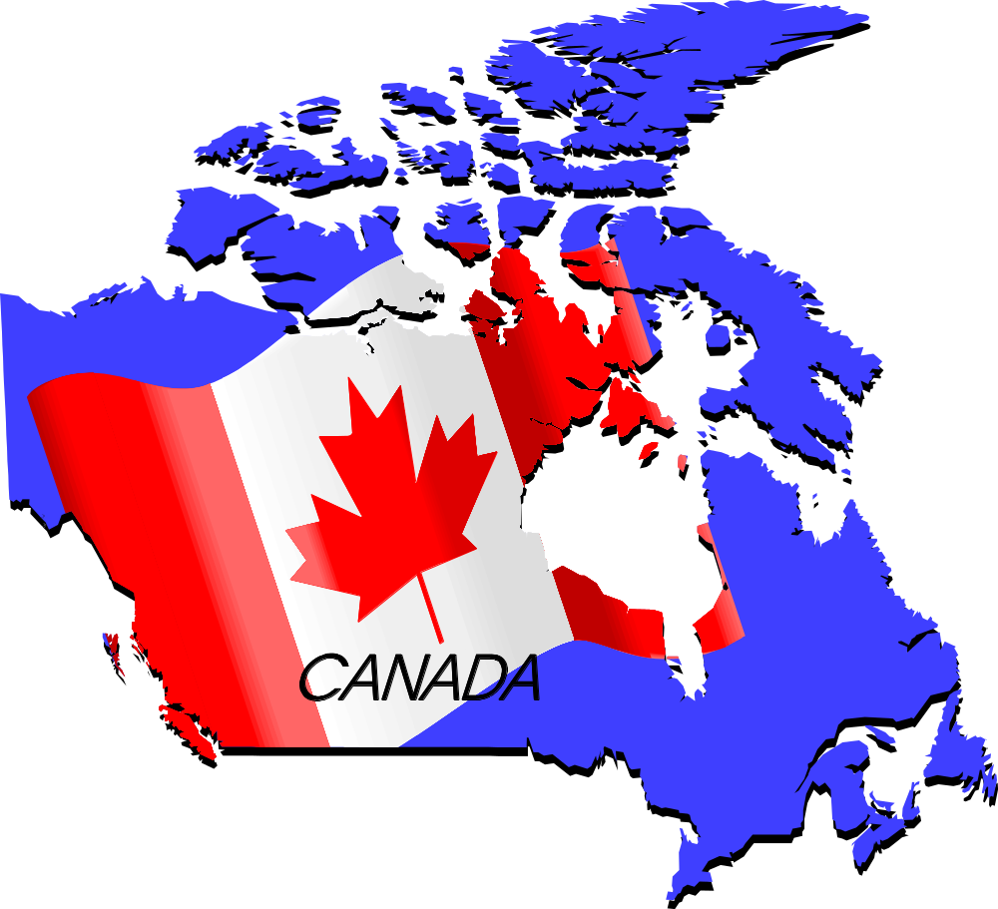
CANADA
According to Sam Pearson, Diana Olexin, & Jessica Steingard

Slide 2

I am Canadian …
Hey, I'm not a lumberjack, or a fur trader....
I don't live in an igloo or eat blubber, or own a dogsled....
and I don't know Jimmy, Sally or Suzy from Canada,
although I'm certain they're really really nice.
I have a Prime Minister, not a president.
I speak English and French, not American.
And I pronounce it 'about', not 'a boot'.
I can proudly sew my country's flag on my backpack.
I believe in peace keeping, not policing,
diversity, not assimilation,
and that the beaver is a truly proud and noble animal.
A toque is a hat, a chesterfield is a couch,
and it is pronounced 'zed' not 'zee', 'zed' !!!!
Canada is the second largest landmass!
The first nation of hockey!
and the best part of North America?
My name is Joe!!
And I am Canadian!!!

Slide 3
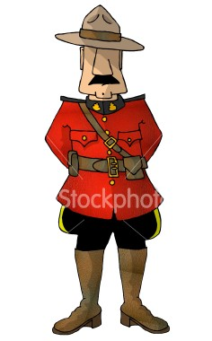
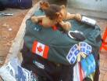

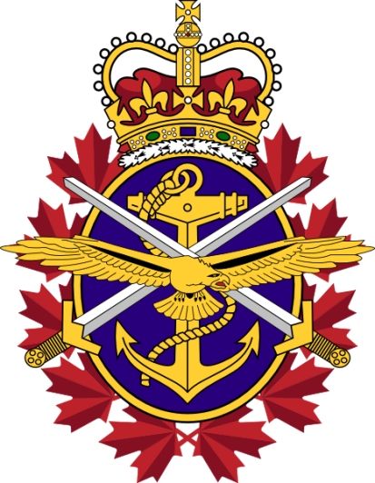
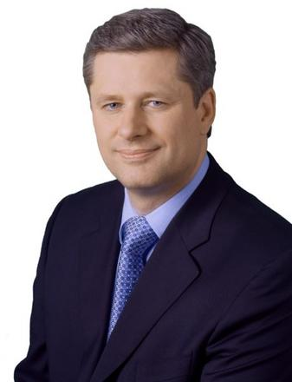
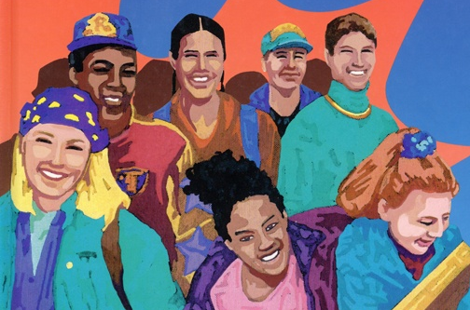

Our Canadian Identity

Slide 4
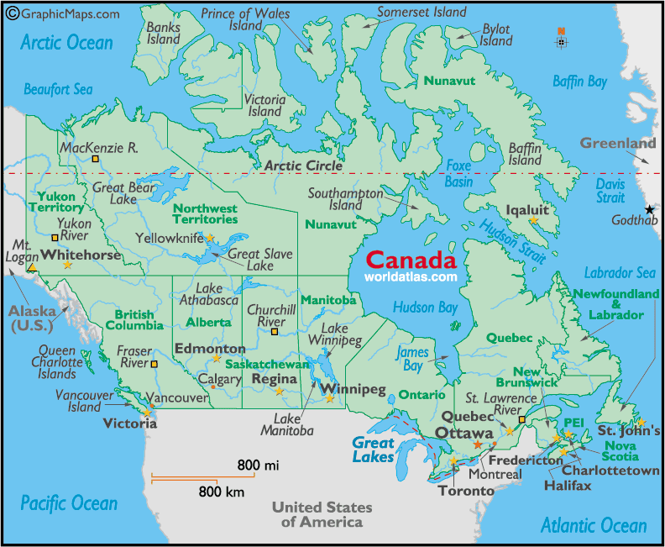
Hey, I'm not a lumberjack, or a fur trader....
I don't live in an igloo or eat blubber, or own a dogsled....
Canadian History
The Discovery

Slide 5
Hey, I'm not a lumberjack, or a fur trader....
I don't live in an igloo or eat blubber, or own a dogsled....
Canadian History
Coming of Age…400 years later
July 1, 1867 Happy Birthday Canada!!
Nov. 7, 1885 Hi, we Canada?
Apr. 9, 1917 We’re big kids now!!
Dec. 11, 1931 You can’t tell us what to do!!
Apr. 17, 1982 A Charter…A Country?

Slide 6

and I don't know Jimmy, Sally or Suzy from Canada,
although I'm certain they're really really nice.
Canadian Vibe
Are you feeling it yet??!!

Slide 7
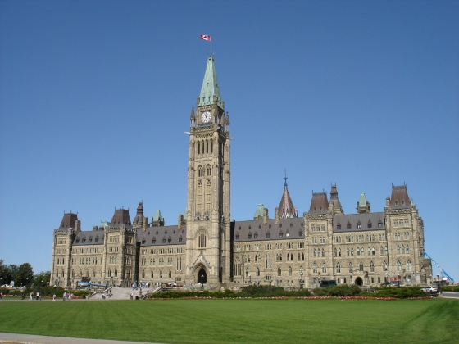
I have a Prime Minister, not a president.
Government
Federal Government
Executive
Legislative
Judicial
Queen
(Governor General)
Prime Minister
Cabinet
Civil Service
House of Commons
Senate
Independent of Parliament
Highest Body is Supreme Court
Makes the Law
Interprets the Law
Enforces the Law

Slide 8
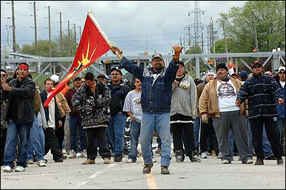

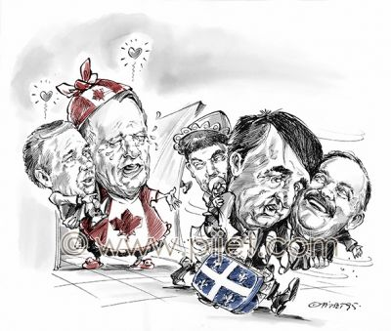
I speak English and French, not American.
Culture Tension
Aboriginal Rights
Quebec Separation
51% Canada 49% Quebec

Slide 9
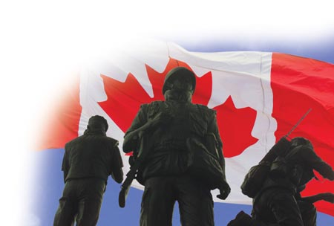
I can proudly sew my country's flag on my backpack.
I believe in peace keeping, not policing,
Peacekeeping
The military act of “Peacekeeping” is one that Canadians far and wide hold close to their hearts and support fully. Peacekeeping is defined as, “the action of a third party between warring forces, enforcing a cease fire or other truce, usually in support of political moves towards a lasting peace settlement.” Simply put, instead of becoming a part of the violence, peacekeepers actively attempt to stop the violence in various ways. Peacekeeping has become somewhat of a “tradition” throughout Canadian culture, and plays a major part in our history. The first United Nations peacekeeping mission Canada found themselves actively involved in occurred in 1948. The objective of this mission was to supervise the cease-fire between Israel and her neighboring Arab countries after the end of the War of Independence. The truce was to be supervised by Canadian monitors. Canada’s first “official” peacekeeping force, however, was not established until 1956 once again in the face of another Middle Eastern conflict. This conflict, the Suez Canal crisis. The Egyptian President, Gamal Abdal Nasser, declared he was intending to nationalize the canal. This made the super-powers of the world at the time very unhappy and fighting was guaranteed. All until Lester B. Pearson proposed that a UN sponsored force, composed of soldiers from countries not involved in the fighting, could separate the armies at war and monitor the cease-fire. For his actions and proposal, Lester B. Pearson was awarded the Nobel Peace Prize. Since this monumental
event in history, Canada has been involved in countless peacekeeping operations including efforts in: Iraq / Kuwait from April 1991-October 1993, Rwanda from October 1993-March 1996, and most notably Bosnia and Herzegovina from December 1995-December 2002. The majority of Canadians still maintain their “peacekeeping, not policing” stance, although, with their current involvement in Afghanistan, many Canadians feel that their military has lost focus of our values and the mission is under much scrutiny. Canada is still currently peacekeeping in fourteen different missions throughout Africa, Europe, Asia, South America, and the Middle East

Slide 10
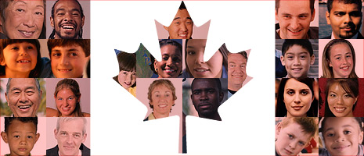
diversity, not assimilation,
Multiculturalism
People of British & French decent constitute more than half of Canada
    Cultures: 28% British 15% European
    26% Mixed 6% Asian, African, or Arab
    23% French 2% Aboriginal / Metis
Languages: French & English
    59% English 23% French 18% Other (2001)
    Religions: 42.6% Roman Catholic 11.8 % Unspecified
    23.3 % Protestant 4.4% Christian
    16% None 1.9% Muslim
Still growing!!!

Slide 11
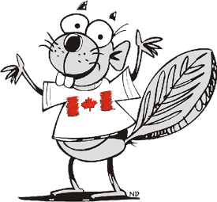
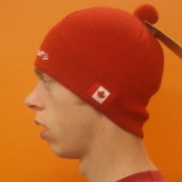

and that the beaver is a truly proud and noble animal.
A toque is a hat, a chesterfield is a couch,
and it is pronounced 'zed' not 'zee', 'zed' !!!!
Canada to Canadians
Like every other country, Canada has its own “Lingo” so to speak. Therefore we have English words in our vocabulary that people in other countries who also speak English won’t necessarily recognize. For example:
“zed”
Toque
Z
Chesterfield
Eh?!

Slide 12
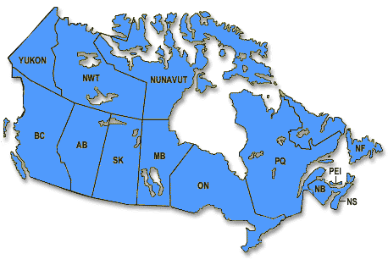
Canada is the second largest landmass!
Geography
Total Area: 9 984 670 sq. km
Water Area: 891 163 sq. km
Land Area: 9 093 507 sq. km
Population: 32 227 000 (2005 census)
Capital City: Ottawa
10 provinces & 3 territories
8 Physiographic Regions:
Canadian Shield
Hudson’s Bay Lowlands
Western Cordillera
Interior Lowlands
Great Lakes Arctic Lowlands
Appalachians Plains
5 Great Lakes – Lake Eerie, Lake Huron, Lake Ontario, Lake Michigan, & Lake Superior (most fresh water in one country surrounded by 3 oceans)
3 Mountain Ranges – Rocky, Coast, & Laurentian
Lowest Point: 0m – Arctic Ocean
Highest Point: 5959m – Mount Logan, Yukon

Slide 13
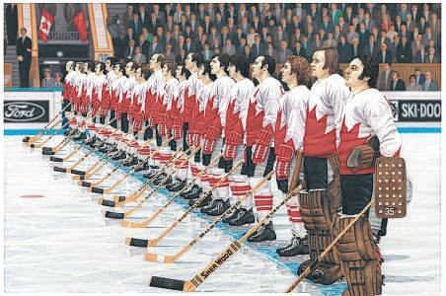
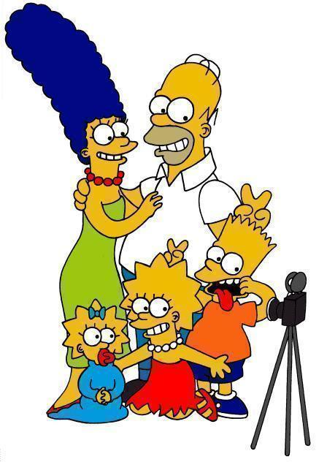
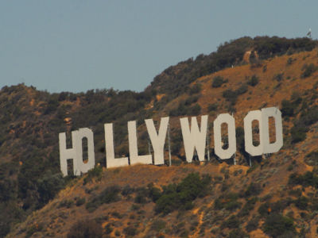

The first nation of hockey!
Canadian Media

Slide 14
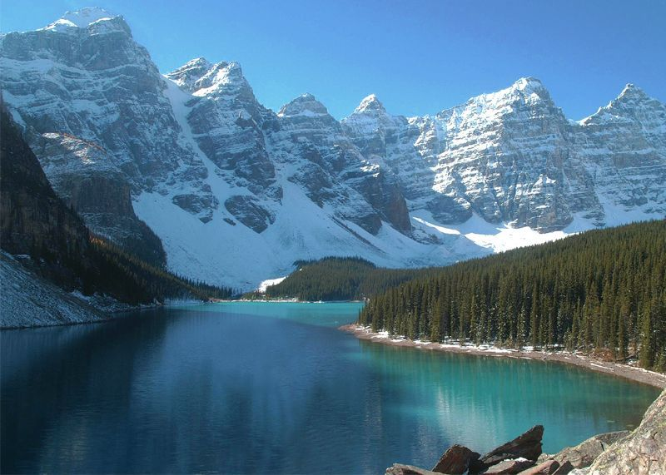
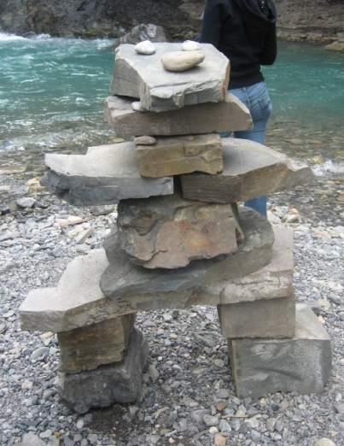
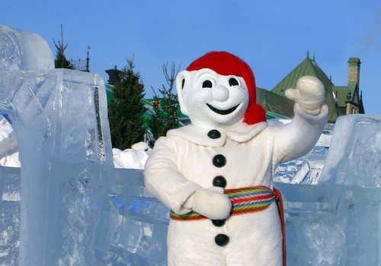
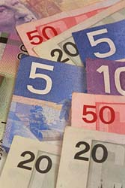
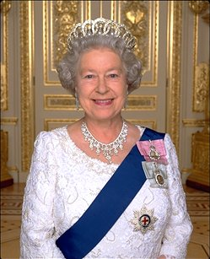
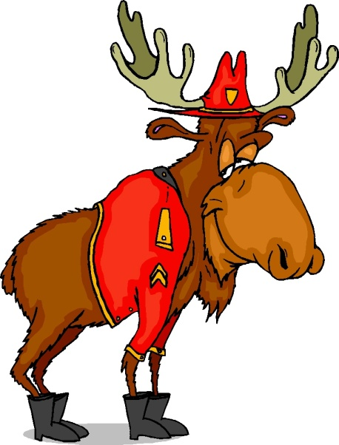
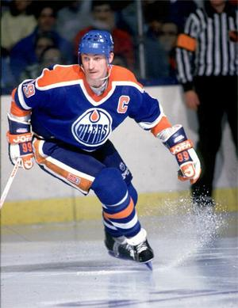
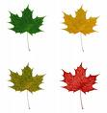



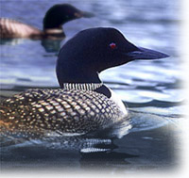
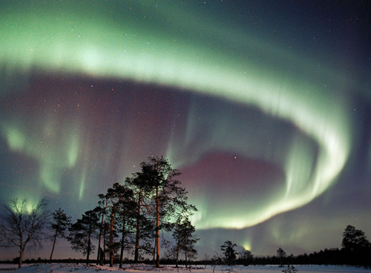
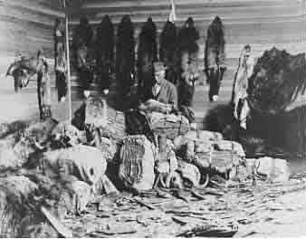

Slide 15

My name is Joe!!
and
I
Am
Canadian!!!

Slide 16
Sources
http://www.pch.gc.ca/progs/multi/inclusive_e.cfm
http://www.answers.com
http://thecanadianencyclopedia.com/index.cfm?PgNm=TCETimelineBrowse&Params=A3CAT1
http://video.canadiancontent.net/5-molson-i-am-canadian.html
http://www.cbc.radio-canada.ca/history/1901-1939.shtml
http://www.nfb.ca/about/

